Slide 1
Aerohive Networks
The Nuts and Bolts of 802.11ax
David Coleman

Slide 2
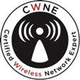
Who is this guy?
David Coleman
Senior Technical Evangelist
@mistermultipath
CWNE #4

Slide 3
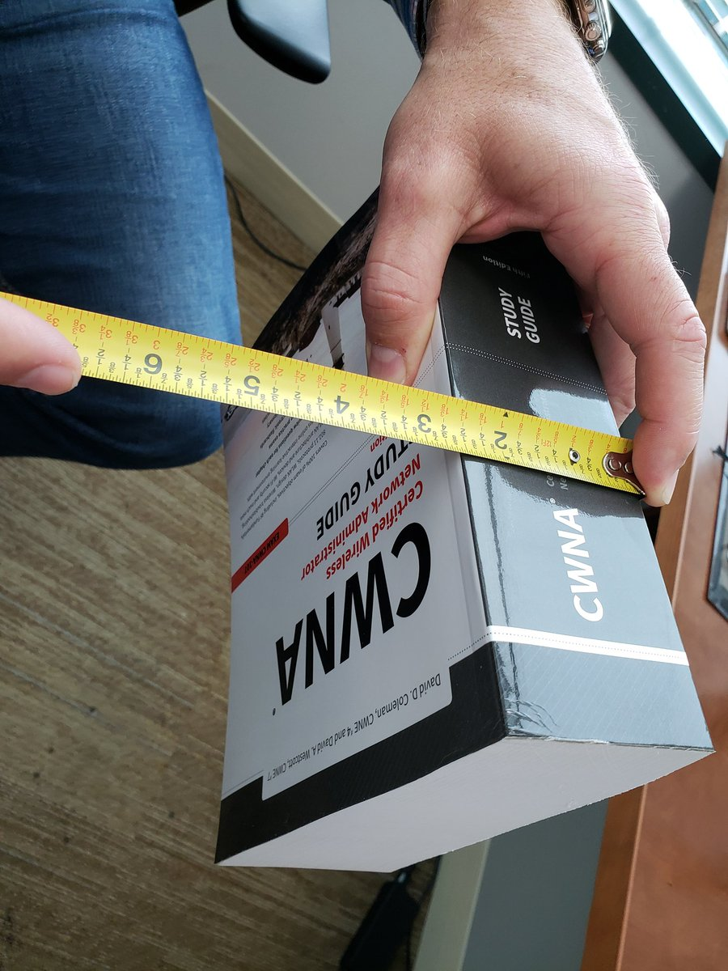
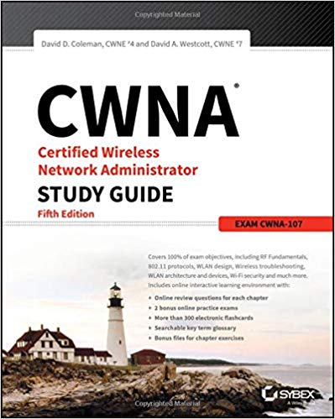
Sybex CWNA Study Guide – 5th Edition
ISBN: 978-1119425786
Amazon: http://bit.ly/CWNAv5

Slide 4
PATENTS
60+
NYSE
HIVE
1st
802.11ax
AP
1st
ENTERPRISE PLUGGABLE AP
1st
PRIVATE
PRE-SHARED
KEY
PIONEERED
CLOUD
NETWORKING
FOUNDED
2006
ONLY
PUBLIC, PRIVATE
& PORTABLE
CLOUD
500+
EMPLOYEES
GLOBAL
CLOUD
FOOTPRINT
30K+
HAPPY
CUSTOMERS

Slide 5
8802.11ax

Slide 6
802.11n and 802.11ac
802.11n and 802.11ac technology introduced new PHY and MAC layer enhancements to achieve high data rates
We built bigger highways and faster cars

Slide 7
But this is the problem:

Slide 8
The solution:

Slide 9
Airtime consumption
RF is a half-duplex medium
At any given time only one radio can transmit on a frequency domain (channel)
Everybody takes turns

Slide 10
Data Rates versus Throughput
Data rate is not TCP throughput
Medium contention protocol of CSMA/CA consumes much of the available bandwidth
Aggregate TCP throughput in a legacy a/b/g environment is 40% – 50% of data rate in ideal conditions
Aggregate TCP throughput in an 802.11n/ac environment is 60% – 70% of data rate in ideal conditions

Slide 11
Traffic nightmare
High density of clients
Efficiency at the MAC sublayer always drops as more clients stations join
Increase in collisions and medium contention overhead

Slide 12
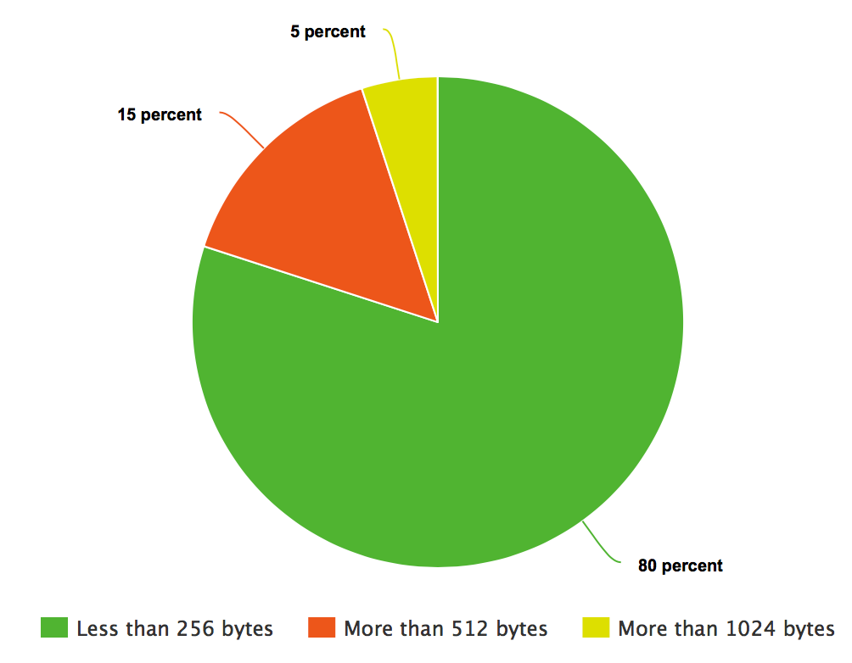
Traffic nightmare
The bulk of of data frames (75 -80%) are small and under 256 bytes
The result is overhead at the MAC layer and medium contention overhead for each small frame

Slide 13
The future: 802.11ax
802.11ax – High Efficiency(HE)
802.11ax uses PHY and MAC layer enhancements for better traffic management
The goal is to increase average throughput 4X per user in high-density scenarios
Operates in both the 2.4 GHz and 5 GHz frequency bands

Slide 14
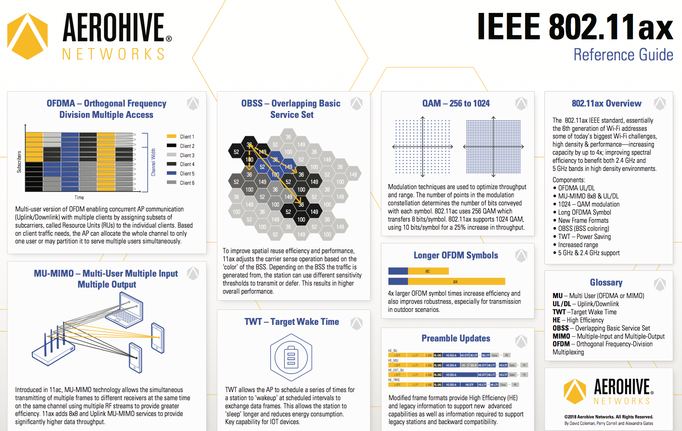
The future: 802.11ax- What is new?
OFDMA – better use of the frequency space
BSS Color/Spatial Reuse – Mitigate OBSS
Uplink and Downlink MU-MIMO for up to 8 devices!
1024-QAM – Higher data rates
Target Wake Time (TWT) – Great for IoT devices

Slide 15
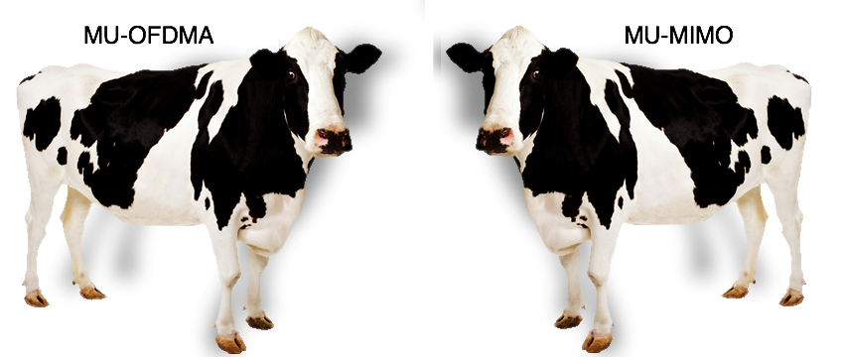
What is the definition of Multi-User (MU) ???
The term multi-user (MU) simply means that transmissions between an AP and multiple clients can occur at the same time dependent on the supported technology.
However, the MU terminology can be very confusing when discussing 802.11ax. MU capabilities exist for both MU-OFDMA and MU-MIMO. Please understand the differences as explained further in this field note.

Slide 16
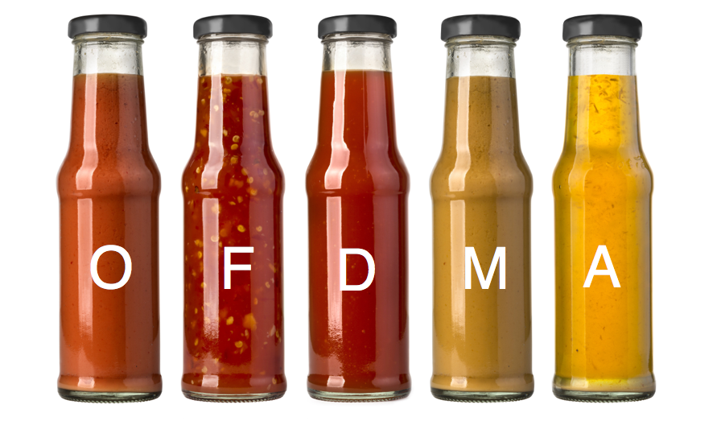
OFDMA is the secret sauce!
Notes:
OFDMA is combination of frequency domain and time domain multiple access

Slide 17
OFDM subcarriers (20 MHz)
64 subcarriers (312.5 kHz)
56 subcarriers (4 pilot and 52 data)
Null
Pilot
Data
20 MHz Channel
OFDM divides bandwidth into subcarriers
Data subcarriers – Carry modulated data
Management Subcarriers – Don’t carry data, they are used for synch and interference protection purposes

Slide 18
OFDM – 802.11a/g/n/ac
Client 1
Client 2
Subcarriers
Client 3
Channel width
Client 4
Client 5
Client 6
Time

Slide 19
OFDMA
Orthogonal Frequency-Division Multiple Access (OFDMA)
Multi-user version of the popular orthogonal frequency-division multiplexing (OFDM) digital modulation scheme
Multiple access is achieved in OFDMA by assigning subsets of subcarriers to individual clients
This allows simultaneous low data rate transmission to/from multiple users.

Slide 20
OFDMA – 802.11ax
Client 1
Resource Unit (RU)
Client 2
Subcarriers
Client 3
Channel width
Client 4
Client 5
Client 6
Time

Slide 21
OFDMA Resource Units
Frequency allocations for both uplink and downlink OFMDA define resource units (RU) with 26, 52, 106, 242, 484 or 996 subcarriers (tones)
The subcarriers (tones) are in fixed locations of each 20, 40 or 80 MHz channel
26
26
26
26
13
13
26
26
26
26
26
52
52
52
52
106
106
242
20 MHz

Slide 22
OFDMA Resource Units
26
26
26
26
13
13
26
26
26
26
9 users
26
52
52
52
52
4 users
106
106
2 users
242
1 user
20 MHz
Based on multi-user traffic needs, the AP decides how to allocate the channel

Slide 23
OFDMA Resource Units
26
26
26
26
13
13
26
26
26
26
9 users
26
52
52
52
52
4 users
106
106
2 users
242
1 user
20 MHz
AP may allocate the whole channel to only one user at a time or it may partition it to serve multiple users simultaneously

Slide 24
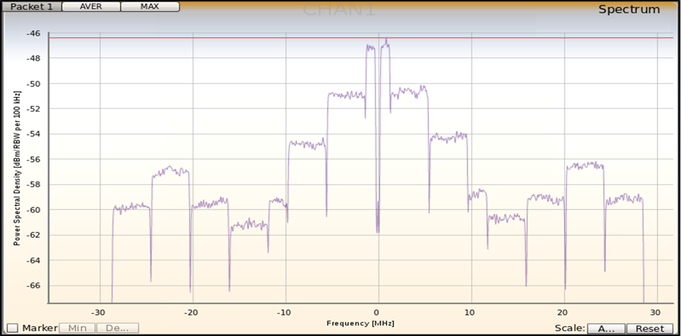
Spectrum analyzer view of OFDMA Resource Units

Slide 25
OFDMA – The AP is in charge!
The rules of medium contention still apply.
The AP still has to compete against legacy 802.11 stations for a transmission opportunity (TXOP).
Once the AP has a TXOP, the AP is then in control of up to nine 802.11ax client stations for either downlink or uplink transmissions.
The number of RUs used can vary on a per TXOP basis.
STA 1
STA 2
STA 3
STA 4

Slide 26
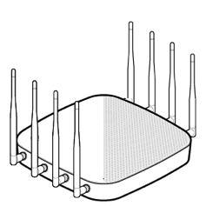
Downlink MU-OFDMA
Multi-user DL-PPDU
802.11ax AP
Trigger
802.11ax clients
STA 4 RU 4 : 52 tones
STA 3 RU 3 : 52 tones
STA 2 RU 2 : 52 tones
STA 1 RU 1 : 52 tones
AP
AIFS
MU-RTS
SIFS
SIFS
SIFS
BAR
SIFS
CTS
Block ACK
STA 1
CTS
Block ACK
STA 2
CTS
Block ACK
STA 3
CTS
Block ACK
STA 4

Slide 27
Downlink MU-OFDMA
802.11ax AP
Trigger
802.11ax clients
AP
MU-RTS
Multi-user DL-PPDU
Block ACK
STA 1
CTS
Block ACK
STA 2
CTS
STA 4 RU 4 : 52 tones
STA 3 RU 3 : 52 tones
STA 2 RU 2 : 52 tones
STA 1 RU 1 : 52 tones
Block ACK
STA 3
CTS
Block ACK
STA4
CTS

Slide 28
Uplink MU-OFDMA
802.11ax AP
Trigger #1
Trigger #2
Trigger #3
802.11ax clients
Multi-STA Block ACK
AP
AIFS
BSRP
SIFS
SIFS
SIFS
SIFS
v
SIFS
SIFS
MU-RTS
Trigger
BSR
CTS
UL-PPDU
STA 1
BSR
CTS
UL-PPDU
STA 2
PAD
BSR
CTS
UL-PPDU
STA 3
BSR
CTS
UL-PPDU
STA 4
Notes:
UL-OFDMA is more complex than DL-OFDMA and may require the use of as many as three trigger frames. Each trigger frame is used to solicit a specific type of response from the Wi-Fi 6 clients. UL-OFDMA also requires the use of buffer status report (BSR) frames from the clients. Clients use BSR frames to inform the AP about the client’s buffered data and about the QoS category of data. The information contained in BSR frames assists the AP in allocating RUs for synchronized uplink transmissions. The AP will use the information gathered from the clients to build uplink window times, client RU allocation, and client power settings for each RU. Buffer status reports (BSRs) can be unsolicited or solicited. If solicited, the AP will poll the clients for BSRs.

Slide 29
Uplink MU-OFDMA
Trigger #1
Trigger #2
802.11ax AP
Trigger #3
AP
Multi-STA Block ACK
BSRP
MU-RTS
Trigger
UL-PPDU
STA 1
CTS
BSR
CTS
STA 2
UL-PPDU
BSR
CTS
STA 3
UL-PPDU
BSR
CTS
STA 4
BSR
UL-PPDU
802.11ax clients
Notes:
For UL-OFDMA, a trigger frame sent by the AP is also used to tell the clients how many spatial streams and which modulation and coding scheme (MCS) to use when transmitting uplink on their assigned RUs. This information can be found in the SS Allocation and UL MCS subfields of the user information field within the body of a trigger frame.
Trigger frames can also be used by an AP to tell clients to adjust their power settings for synchronized uplink transmissions. Within a trigger frame, the UL Target RSSI subfield indicates, in a dBm value, the expected receive power at the AP across all antennas for the assigned resource unit (RU) transmissions from the uplink 802.11ax clients. The UL Target RSSI subfield uses values of 0 to 90 which are directly mapped from –110 dBm to –20 dBm. A value of 127 indicates to the client station to transmit at its maximum power for the assigned MCS. Based on this information provided by the trigger frame, the transmit power could be adjusted by the uplink clients. Please note that a client station might be unable to satisfy the target RSSI due to its hardware or regulatory limitations.

Slide 30
Uplink MU-OFDMA
AP sends ‘Trigger’ to alert clients when to transmit
Client 1
Client 2
Subcarriers
Client 3
Client 4
Client 5
Client 6
Time
30
Notes:
AP Still Controls the Medium
Process Overview
AP sends a Trigger Frame - Buffer Status Report Request (BSRR)
Clients reply synchronized Buffer Status Report (BSR) frames
Information about their AID, data length, Type of Date (QoS)
AP builds RU schedule with following information
Start, Stop times / Client RU Mapping / RUs per clients / MCS setting/ Power Levels per RU /
AP sends MU-RTS
CTS responses from the clients in parallel (RU)
AP sends Trigger to allocate the RUs and time-sync
Clients send UL-DATA via their assigned RUs
Multi-User Block ACK from the AP

Slide 31
Buffer Status Reports
APs require specifics on client buffer states to perform appropriate RU scheduling, two approaches available:
Clients deliver Buffer Status Reports (BSRs) to assist the AP in allocating UL MU resources.
Clients can explicitly deliver BSRs to the AP in response to a BSRP trigger frame (solicited BSR).
Clients can implicitly deliver BSRs in the QoS Control field or BSR Control field of any frame transmitted to the AP (unsolicited BSR)
In either case AP will determine client transmit requirements
Notes:
Additionally, the buffer status report poll (BSRP) trigger frame is not needed when the Wi-Fi 6 clients send unsolicited buffer status report information. Clients can send unsolicited BSRs in frames using either of these subfields:
QoS Control field: Wi-Fi 6 client station can report buffer status information for any given QoS class of traffic in the Queue Size subfield of the QoS Control field in QoS Data or QoS Null frames it transmits. Additionally, an 802.11ax client can report the buffer status of multiple QoS access categories using A-MPDU frame aggregation of QoS Data or QoS Null frames. Traffic identifiers (TIDs) are used to indicate the QoS access category of the buffered client traffic. The Queue Size subfield indicates the amount of buffered traffic for any given traffic class.
BSR Control field: See the next slide

Slide 32
Unsolicited buffer status reports and A-MPDU
BSR - Voice
BSR - Voice
BSR - Video
MPDU-1
MPDU-2
MPDU-3
I need to send some buffered voice and video traffic!
PHY header
MAC
header
MSDU-1
Trailer
MAC
header
MSDU-2
Trailer
MAC
header
MSDU-3
Trailer
PHY
header
MAC
header
BlockACK
Wi-Fi 6 client station can report unsolicited buffer status information for any given QoS class of traffic in any QoS Data or QoS Null frames it transmits.
Additionally, an 802.11ax client can report the buffer status of multiple QoS access categories using A-MPDU frame aggregation of QoS Data or QoS Null frames.

Slide 33
RU Allocation
26 tone RU | RU-1 | RU-2 | RU-3 | RU-4 | RU-5 | RU-6 | RU-7 | RU-8 | RU-9
Subcarrier range | -121:-96 | -95:-70 | -68:-43 | -42:-17 | -16:-4, 4:16 | 17:42 | 43:68 | 70:95 | 96:121
RU allocation bits | 0000000 | 0000001 | 0000010 | 0000011 | 0000100 | 0000101 | 0000110 | 0000111 | 0001000
52 tone RU | RU-1 |  | RU-2 |  |  | RU-3 |  | RU-4
Subcarrier range | -121:-70 |  | -68:-17 |  |  | 17:68 |  | 70:121
RU allocation bits | 0100101 |  | 0100110 |  |  | 0100111 |  | 0101000
106 tone RU | RU-1 |  |  |  |  | RU-2
Subcarrier range | -122:-17 |  |  |  |  | 17:122
RU allocation bits | 0110101 |  |  |  |  | 0110110
242 tone RU | RU-1
Subcarrier range | -122:-2, 2:122
RU allocation bits | 0111101
Notes:
As previously mentioned, trigger frames contain information about RU allocation. RU allocation information is communicated to clients at both the PHY and MAC layers. RU allocation information can be found in the HE-SIG-B field of the PHY header of an 802.11 trigger frame.
Additionally RU allocation information is delivered in the user information field in the body of a trigger frame. This slide displays a table of how RU allocation information is communicated at the MAC layer.
The table highlights all the possible RUs within a 20 MHz channel and the subcarrier range for each RU. Each specific RU is defined by a unique combination of 7 bits within the user information field of the trigger frame.

Slide 34
RU Allocation
Trigger
802.11ax AP
Multi-STA Block ACK
802.11ax clients
Trigger
SIFS
SIFS
STA 1: 52 tone – RU-1
Subcarriers: -121:-70
Bit index: 0100101
STA 1
STA 2: 52 tone – RU-2
Subcarriers: -68:-17
Bit index: 0100110
STA 2
STA 3: 106 tone - RU-2
Subcarriers: 17:122
Bit index: 0110110
STA 3
Notes:
In the example, the trigger frame allocates specific RUs to three client stations for simultaneous uplink transmission within a 20 MHZ ODMA channel. Client STA-1 and STA-2 are each assigned to a 52-tone RU while client STA-3 is assigned to a 106-tone RU.

Slide 35
Operating mode indication (OMI)
OMI initiator
OMI responder
I want to contend for the medium all by myself, and go single user!
Fine…. Be that way!
The client can suspend and resume Uplink Multiuser operation and/or Downlink Multiuser operation.

Slide 36
MU-MIMO

Slide 37
MU-MIMO
AP
User1
User2
AP use DL MU-MIMO to serve multiple clients requires spatially diverse position.
AP can specify multiple STA to simultaneously send uplink frames via trigger frames.

Slide 38
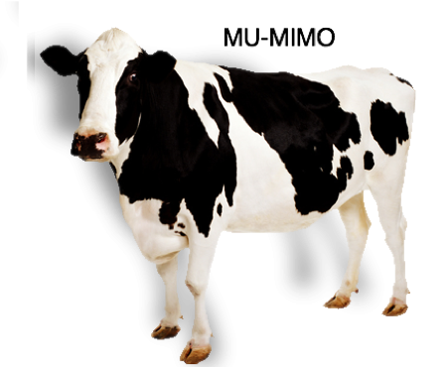
MU-MIMO….. not so much
Less than 5% of the currently available clients support MU-MIMO
Hardly any MU-MIMO capable clients exist in the current marketplace and the technology is rarely used in the enterprise

Slide 39
MU-MIMO
Even if all clients supported MU-MIMO, the majority of modern-day enterprise deployments of Wi-Fi involve a high density of users that is not conducive for MU-MIMO conditions
MU-MIMO requires spatial diversity, therefore physical distance between the clients is necessary
20 feet
20 feet
30 feet
25 feet
15feet

Slide 40
MU-MIMO
The majority of modern-day indoor enterprise deployments of Wi-Fi involve a high density of users that is not conducive for MU-MIMO conditions

Slide 41
Which is better… MU-OFDMA or MU-MIMO?
Downlink MU-MIMO was introduced with Wave-2 802.11ac access points, however, real-world implementation of MU-MIMO has still not occurred and currently is not practical:
MU-MIMO requires transmit beamforming (TXBF) which requires sounding frames. The sounding frames add excessive overhead, especially when the bulk of data frames are small
MU-MIMO would only be a favorable option in very low client density, high bandwidth environments
Support for uplink MU-MIMO will not be in 1st generation chipsets

Slide 42
BSS Color

Slide 43
Co-Channel Interference (CCI)
Does RF just stop?
Almost impossible to prevent CCI at 2.4 GHz
Channel 11
Channel 1
Channel 1
Channel 6

Slide 44
Co-Channel Interference (CCI)
CCI is not static and always changing
Client transmissions cause CCI
Channel 11
Channel 1
Channel 1
Channel 6

Slide 45
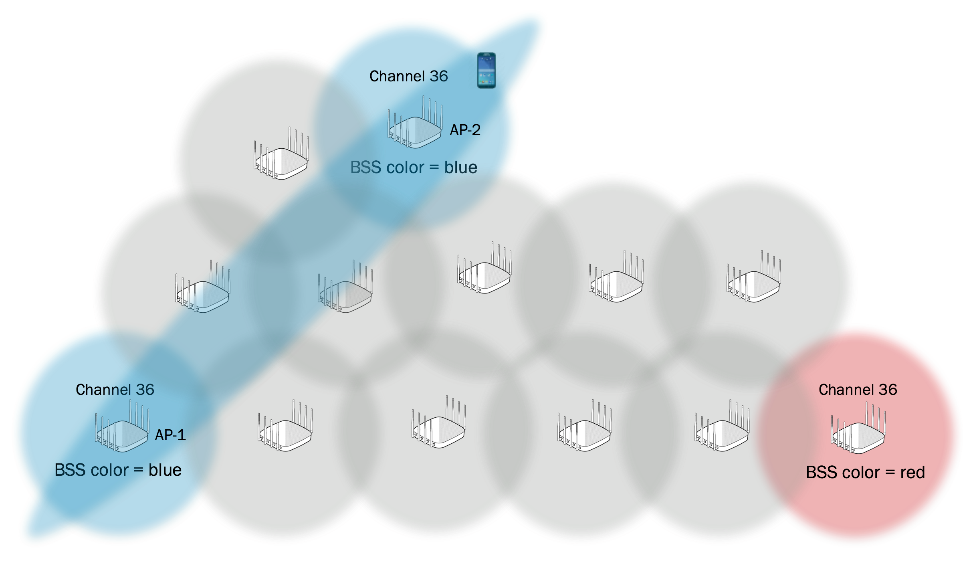
BSS Color
The BSS color is a numerical identifier (color) of the BSS
802.11ax radios are able to differentiate between BSSs using BSS color identifier when other radios transmit on the same channel

Slide 46
BSS Color – Spatial Reuse
intra-BSS
inter-BSS
-76 dBm
CCA – energy detect threshold
-83 dBm
CCA – Adaptive signal detect threshold
-96 dBm
+ 4 dB
-100 dBm
Noise Floor
Adaptive CCA implementation could raise Signal Detect threshold for inter-BSS frames, while maintaining a lower threshold for intra-BSS traffic

Slide 47
Additional 802.11ax capabilities

Slide 48
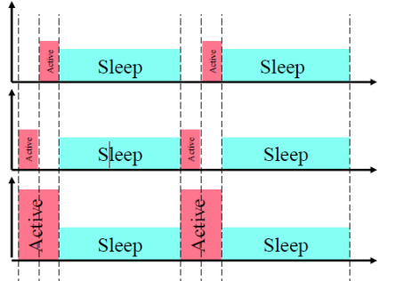
Target Wake Time
Target Wake Time (TWT) is a power saving mechanism in 802.11ah, negotiated between a STA and its AP, which allows the STA to sleep for periods of time, and wake up in pre-scheduled (target) times to exchange information with its AP
This allows the station to ‘sleep’ longer and reducing energy consumption.
Key feature for IoT type sensors

Slide 49
Target Wake Time
Devices can sleep for longer periods
Saves battery life
Ideal for IoT devices

Slide 50
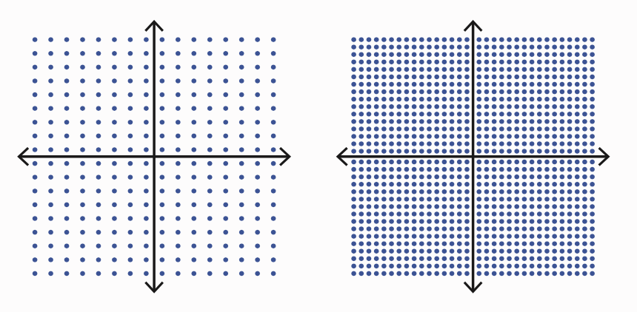
1024-QAM modulation
Much like 256-QAM, we anticipate that very high SNR thresholds (~ 35 dB) will be needed in order for 802.11ax radios to use 1024-QAM modulation.
Notes:
Although the goal of 802.1ax is better efficiency as opposed to higher data rates, there is one exception. First generation 802.11ax radios will support 1024-QAM modulation which will also mean some new modulation and code schemes (MCS) that define some higher data rates. 256-QAM modulates 8 bits per symbol whereas 1024-QAM modulates 10 bits per symbol, meaning there is potential 20 percent increase in throughput.
As a result, 802.11ax introduces two new modulation and coding schemes, MSC-10 and MSC-11 which will most likely be optional. 1024-QAM can only be used with 242-tone resource units or larger. This means that at least a full 20 MHz channel will be needed for 1024-QAM.

Slide 51
802.11ax Key Questions

Slide 52
Wi-Fi Alliance
Wi-Fi Alliance has introduced a new generational Wi-Fi naming system that helps users better understand the experience they can expect
Wi-Fi 6 is the next generation of Wi-Fi based on 802.11ax technology: www.wi-fi.org/wi-fi-6
802.11ax
802.11ac
802.11n

Slide 53
Is there any benefit for legacy clients?
The answer is yes and no!
802.11ax APs will not improve the performance or range of any legacy Wi-Fi clients (802.11a/b/g/n/ac)
802.11ax clients will be needed to take full advantage of 802.11ax high efficiency capabilities such as multi-user OFDMA

Slide 54
Is there any benefit for legacy clients?
The answer is yes and no!
However, as we see more 802.11ax clients mixed into the client population, the efficiency improvements gained by 802.11ax client devices will free valuable airtime for those older clients, therefore improving the overall efficiency of the system.
There will be also be enhanced performance as a result of newer hardware capabilities of the new 802.11ax APs, such as stronger CPUs, better memory handling, etc.

Slide 55
The Elephant in the room!
Where are the 802.11ax clients?

Slide 56
The Elephant in the room!
Where are the 802.11ax clients?
We all know that there are no 802.11ax clients yet
They are coming!
Broadcom 2x2:2
Qualcomm 2x2:2
Intel 2x2:2
Notes:
1 billion Wi-Fi 6 chipsets will ship annually by 2022
Source: ABI Research

Slide 57
Wi-Fi 6 clients coming soon!
Vendors announcing 802.11ax end-user devices:
HP OMEN Asus ROG Mothership
Samsung Galaxy S10 & S10+
ABI Research: 1 billion Wi-Fi 6 chipsets will ship annually by 2022

Slide 58
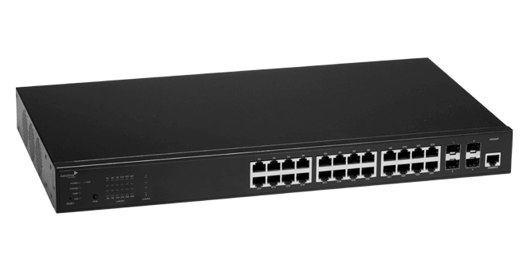
What about uplink connections?
Some of our competitors are claiming we will need 10 Gbps uplinks from 802.11ax APs. Is this true?
NO!
Bandwidth bottlenecks are almost always the WAN uplink

Slide 59
Will we need MultiGig switch ports?
Will we at least need 2.5 MultiGig (802.3bz) Ethernet ports?
As 802.11ax client populations grow, 2.5 MultiGig may be needed

Slide 60
Will we need MultiGig switch ports?
Aerohive’s Dual 5-GHz radio capability makes this even more likely!
The AP650 and AP650X will each have a 2.5G and 1G (full duplex) Ethernet uplink port.

Slide 61
Will 802.11ax APs work with 802.3af PoE?
The extra radio chains and quad-core processor will require more power
802.3at PoE Plus power of 25 watts will be required
PoE Plus requirements for 4x4:4 MIMO APs should be considered a standard requirement

Slide 62
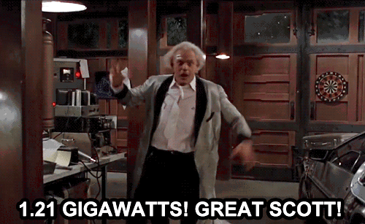
Will 802.11ax APs work with 802.3af PoE?
Some vendors will have 8x8:8 APs
Power of 31 watts per port and much higher will be a requirement for 8x8:8 APs
Or two PoE Plus cable runs

Slide 63
Which is better? 8x8:8 or 4x4:4 APs?
Some of our competitors may manufacture an 8x8:8 access point using a Qualcomm IPQ8074 chipset. It will support eight 5 GHz streams and four 2.4 GHz streams. Some key points should be understood about 8x8:8 APs versus 4x4:4 802.11ax APs:
8x8:8 APs will initially be more expensive and require more power
8x8:8 APs do not offer more client connectivity per AP

Slide 64
POWER HOGS
8x8:8 APs will be power hogs
Power of 31 watts per port or much higher will be a requirement for 8x8:8 APs
Two PoE Plus cable runs will be needed or else the AP radio downgrades to a 4x4:4

Slide 65
Which is better? 8x8:8 or 4x4:4 APs?
The main advantage of 8x8:8 AP is to take advantage of MU-MIMO capabilities which 802.11ax clients will need to support:
Less than 5% of the currently available clients support MU-MIMO
Hardly any MU-MIMO capable clients exist in the current marketplace and the technology is rarely used in the enterprise

Slide 66
Which is better? 8x8:8 or 4x4:4 APs?
Even if all clients supported MU-MIMO, the majority of modern-day enterprise deployments of Wi-Fi involve a high density of users that is not conducive for MU-MIMO conditions
MU-MIMO requires spatial diversity, therefore physical distance between the clients is necessary
20 feet
20 feet
30 feet
25 feet
15feet

Slide 67
Which is better? 8x8:8 or 4x4:4 APs?
Some of our competitors may manufacture an 8x8:8 access point using a Qualcomm IPQ8074 chipset. It will support eight 5 GHz streams and four 2.4 GHz streams. Some key points should be understood about 8x8:8 APs versus 4x4:4 802.11ax APs:
Marketing Fallacy #1: Vendor-X will claim that 8x8:8 AP will support more clients than 4x4:4 AP
Nonsense! - Regardless of stream count, all APs will support same number of Wi-Fi 6 capable clients

Slide 68
Which is better? 8x8:8 or 4x4:4 APs?
Radio #1: SDR radio
Radio #2: Fixed 5 GHz Radio
2.4 GHz: Channel 6
5 GHz: Channel 40
5 GHz: Channel 100
The Power of Dual 5 GHz where Aerohive has been a leader!
Two dual-5 GHz 4x4:4 802.11ax radios transmitting on two separate 5 GHz (20 MHz) channels will provide better performance and efficiency.
Notes:
There is no real advantage with an 8x8:8 AP over a 4x4:4 when using the OFDMA technology:
The competitor’s AP 8X8:8 radio will transmit on a single 5 GHz (20 MHz) channel and a single 2.4 GHz (20 MHz) channel.

Slide 69
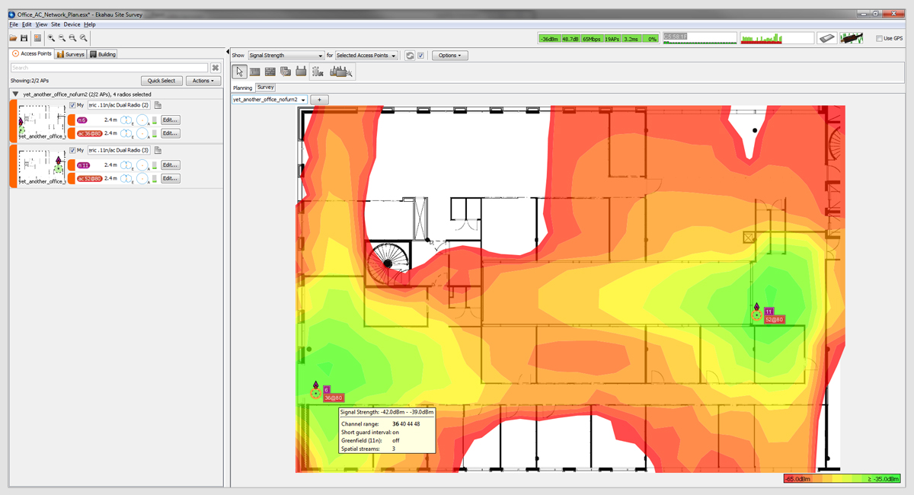
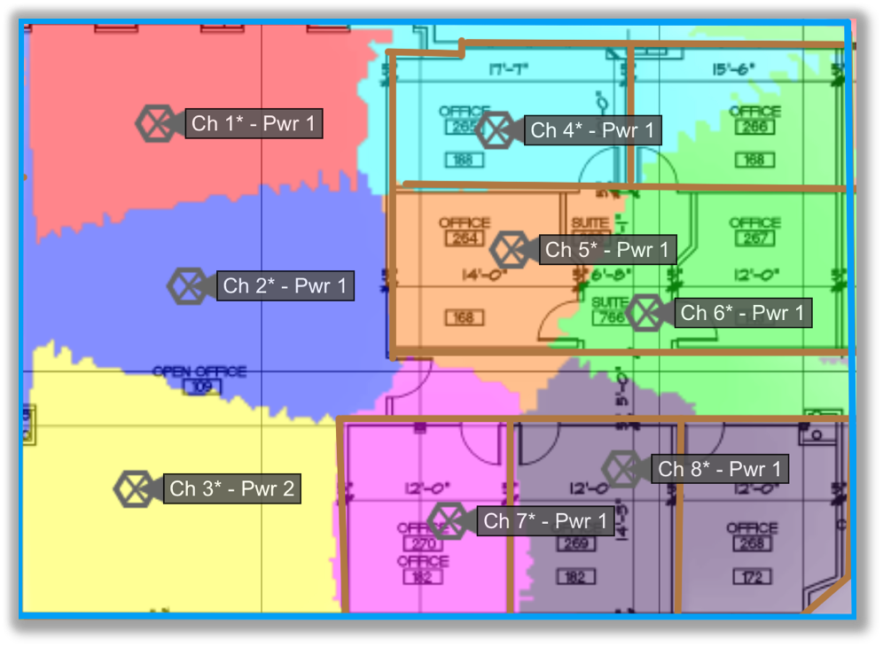
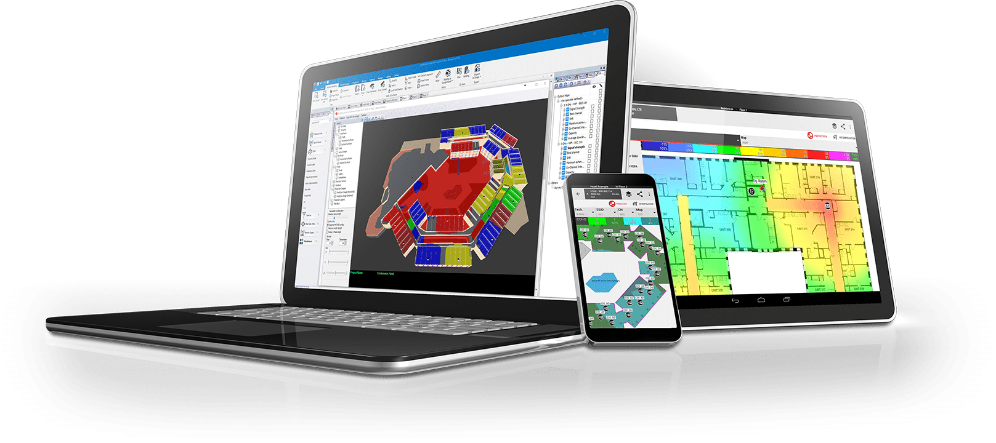
802.11ax WLAN design
802.11ax or any new Wi-Fi technology does not mitigate bad design
Design and validation are still key
Field testing will be vital

Slide 70
802.11ax WLAN troubleshooting
802.11 management and control frames with 802.11ax information elements can be decoded
Already supported in Wi-Fi Explorer and the developer version of Wireshark

Slide 71
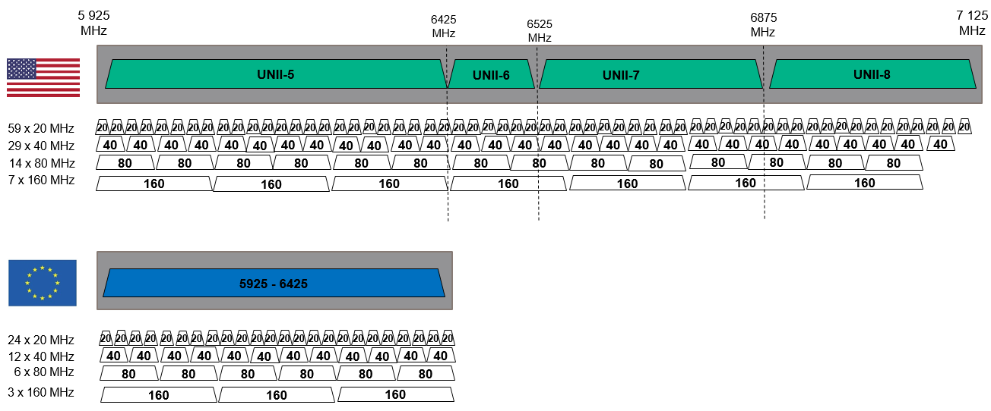
6 Ghz Wi-Fi Channels
U-NII-5: 5925-6425 MHz
U-NII-6: 6425-6525 MHz
U-NII-7: 6525-6875 MHz
U-NII-8: 6875-7125 MHz
Notes:
1.2 GHz more Wi-Fi (unlicensed) spectrum in the 6 GHz band. (UNII 5, 6, 7 & 8).
More than doubles the total amount of bandwidth available for Wi-Fi
But:
FCC
Incumbent services in 6 GHz (Fixed satellite services, cable TV relay, Broadcast services, ( over 58k call signs…)
Broadband will aim to use this band too.
Multiple Power level restrictions
Will need to protect existing and licensed services – whitespace (registry ?)and DFS like protection
EU – Only about half of the 6GHz band is available
IEEE - 11ax D3.2 already references support for 6 GHz band, need to add channel & power restrictions (IEEE).
Wi-Fi Alliance – Discussing adding support in 11ax certification, maybe part of Wave 2 -TBD
Broadcom – Wi-Fi Chipsets supporting 6 GHz in development
Clients - TBD
Aerohive – TBD
Other vendors – it's just marketing
Don’t expect anything to at least 2022

Slide 72
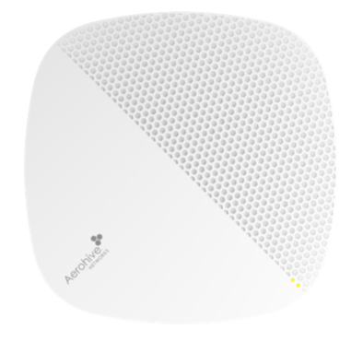
802.11ax – Next generation Wi-Fi has arrived!
AP630
AP650
AP650X
Features:
Internal antennas
4x4 + 4x4 11ax
Dual band radio
1G + 1G ports
BLE / Zigbee / USB
POE+/DC Power
Features:
Internal antennas
4x4 + 4x4 11ax
Dual 5 GHz radio
2.5G + 1G ports
BLE / Zigbee / USB
POE+/DC Power
Redundant PoE capable
Features:
External antennas
4x4 + 4x4 11ax
Dual 5 GHz radio
2.5G + 1G ports
BLE / Zigbee / USB
Outdoor mode
Industrial Temp Range (-20C to +55C)
POE+/DC Power –
Redundant PoE Capable

Slide 73
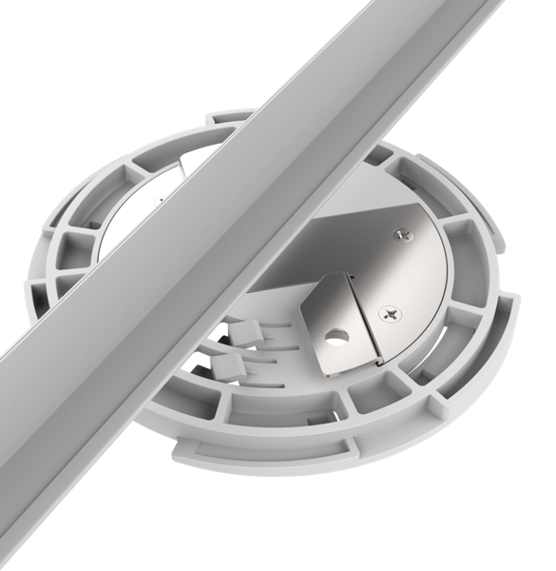
Twist and MOUNt

Slide 74
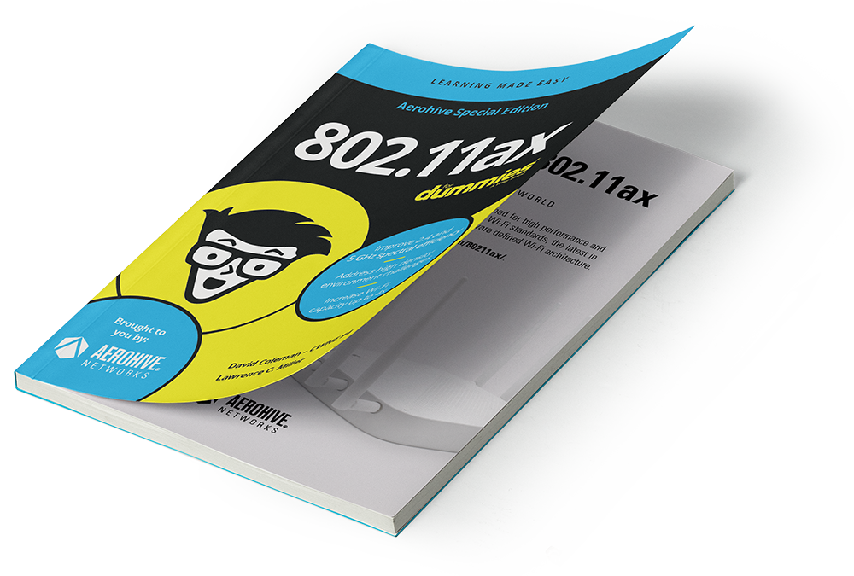
TECHNICAL RESOURCES
802.11ax blog series: https://blog.aerohive.com/tag/11ax/
802.11ax for Dummies Booklet: https://content.aerohive.com/802.11ax_dummies_book

Slide 75
Questions

Slide 76
Thank you

